Slide 1
THE ROLE OF THE
DEPOSIT PROTECTION FUND OF UGANDA (DPF)
TOWN HALL ENGAGEMENT
February 19th, 2026

Slide 2
PRESENTATION OUTLINE
Background to Deposit Insurance
Genesis of the DPF
The Roles and Functions of DPF & How DPF Contributes to Public Confidence
Corporate Governance Structure
Membership and Coverage
Funding and Asset Structure
Take Home messages
1
2
AGENDA
3
4
5
6
7

Slide 3



Background to deposit insurance
Deposit Insurance developed out of the need to protect vulnerable, uninformed small depositors. Started in the USA in the 1930s.
In 2002 the International Association of Deposit (IADI) insurers was created. IADI issues and regularly reviews the core principles that guide operations of deposit insurance globally.
IADI is constituted of 108 members, 10 Associates and 17 Partners.
DPF joined IADI in 2018 as its 82nd member.
3

Slide 4
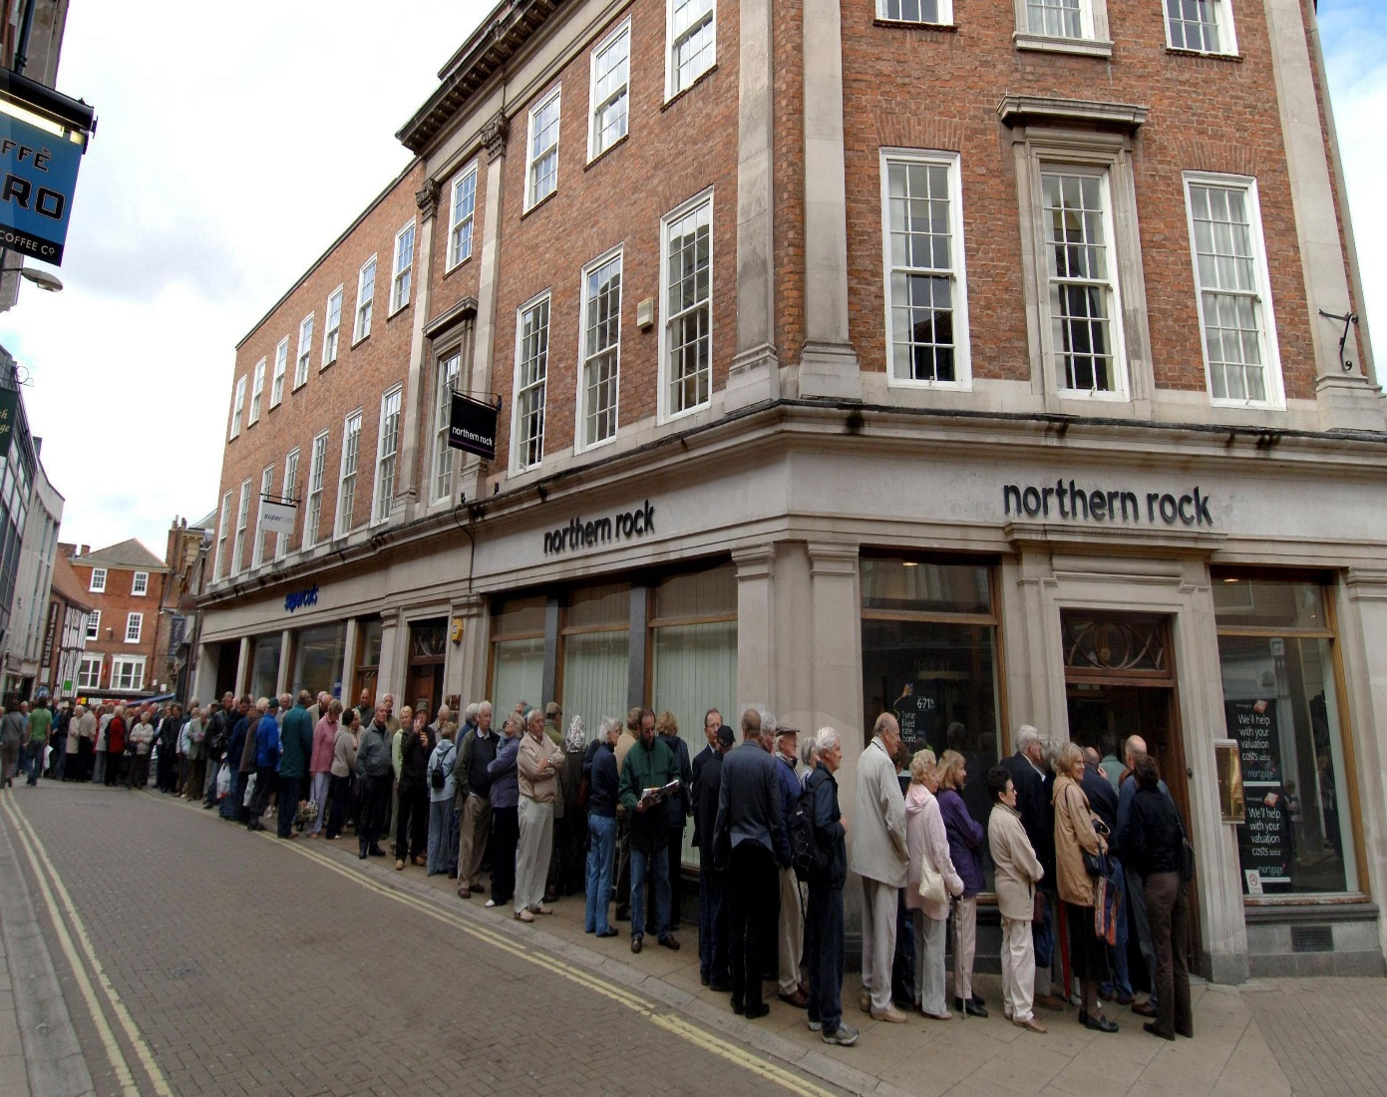
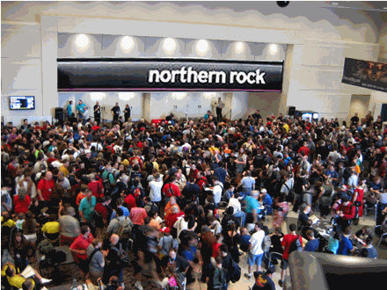
DEPOSITORS OF NORTHERN ROCK BANK QUEUING AT A BRANCH
(DURING THE 2007/2008 FINANCIAL CRISIS)
4

Slide 5





DEPOSIT PROTECTION FUND – THE GENESIS
The Financial Institutions Act, Cap 57 operationalized the Fund as an independent entity.
The Fund is operational & has to-date successfully conducted 2 payouts.
DPF was established in 1994 following the enactment of the Financial Institutions Statute (FIS) 1993.
Consequently, a team of staff were seconded from Bank of Uganda to kickstart independent operations of the Fund.
It continued, managed by Bank of Uganda, under the Financial Institutions Act (FIA) 2004, until 2017.
Establishment
Under BoU
Attainment of Legal Status
Beginning Operations
Current Status

Slide 6





DPF ROLE AND FUNCTIONS
4. Perform any other duty as may be conferred by law.
1. Pay depositors of protected institutions, in the event of closure of a financial institution.
2. Contribute to financial sector stability through Public Awareness.
3. Act as receiver or liquidator if appointed by Bank of Uganda.
6

Slide 7



How DPF contributes to Public Confidence
Ensuring timely and efficient payment of protected deposits.
DPF paid depositors in the now defunct EFC Bank Ltd & Mercantile Credit Bank Ltd, on average - 7 days after closure by the Bank of Uganda in 2024.
The law provides for 90 days.
Ensuring that the public is informed, through awareness campaigns about the role DPF plays in ensuring that customer deposits are protected.
Confidence in the financial system

Slide 8
CORPORATE GOVERNANCE STRUCTURE
01
In line with the provisions of the Financial Institutions Act, Cap 57, DPF is governed by a board of seven members;
02
Two (2) members represent contributing institutions, 2 others represent the public; 1 represents MoFPED, 1 the BoU Governor and 1 the Uganda Bankers Association (UBA).
04
03
The Board upholds best corporate governance principles which are spelt out in the Board Charter and Code of conduct;
03
Governance Principles
The Chief Executive Officer leads a team of seven executive members managing the day-to-day operations.
02
04
Member Representation
01
Board of Seven Members
8

Slide 9
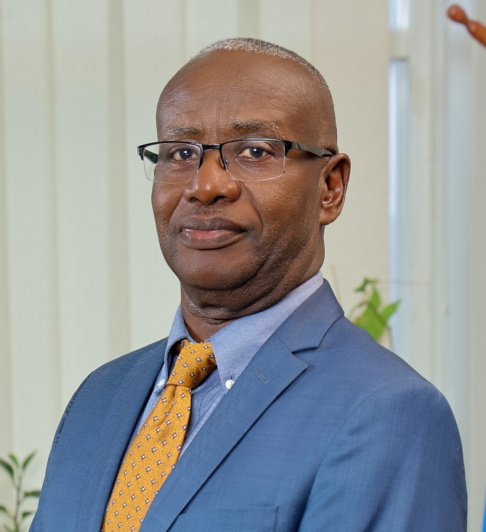
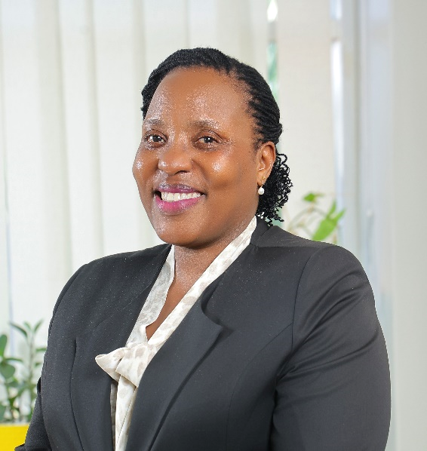
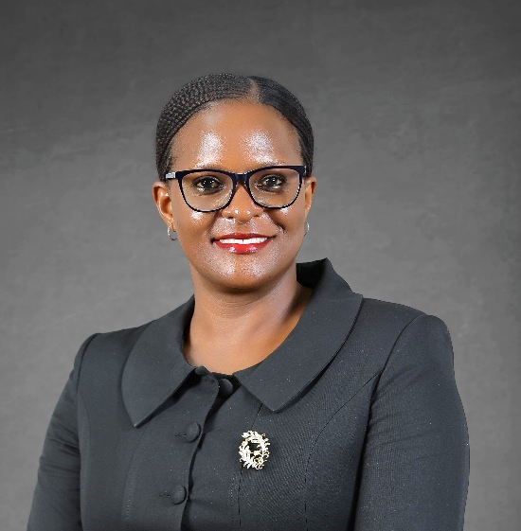
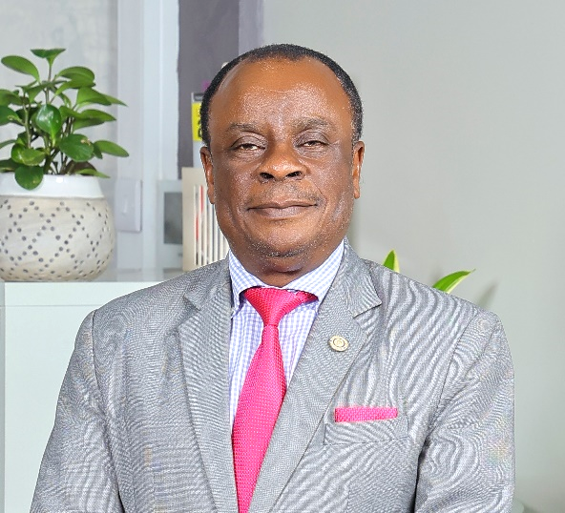
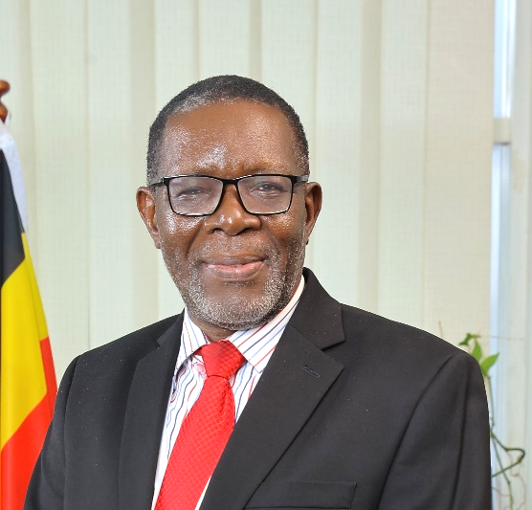
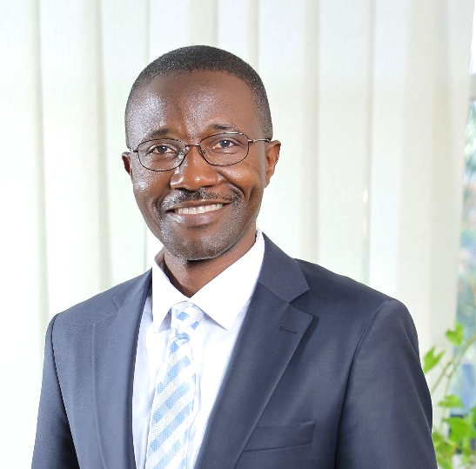
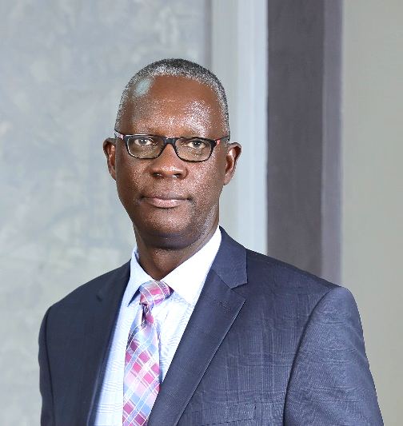
BOARD OF DIRECTORS
9

Slide 10
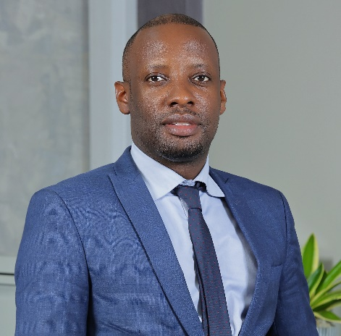
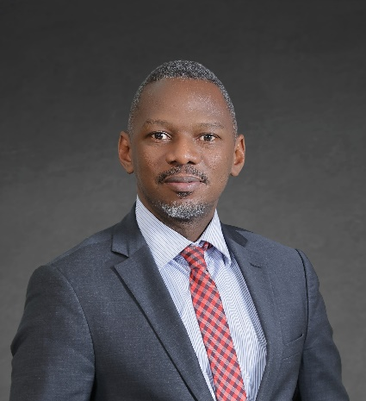
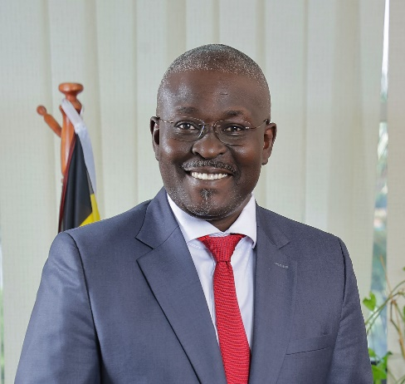
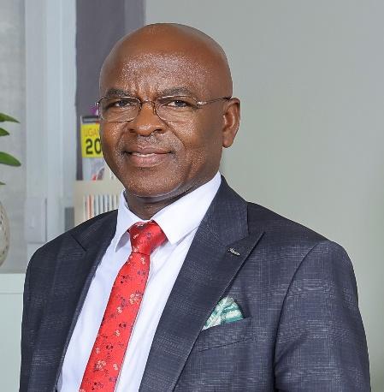
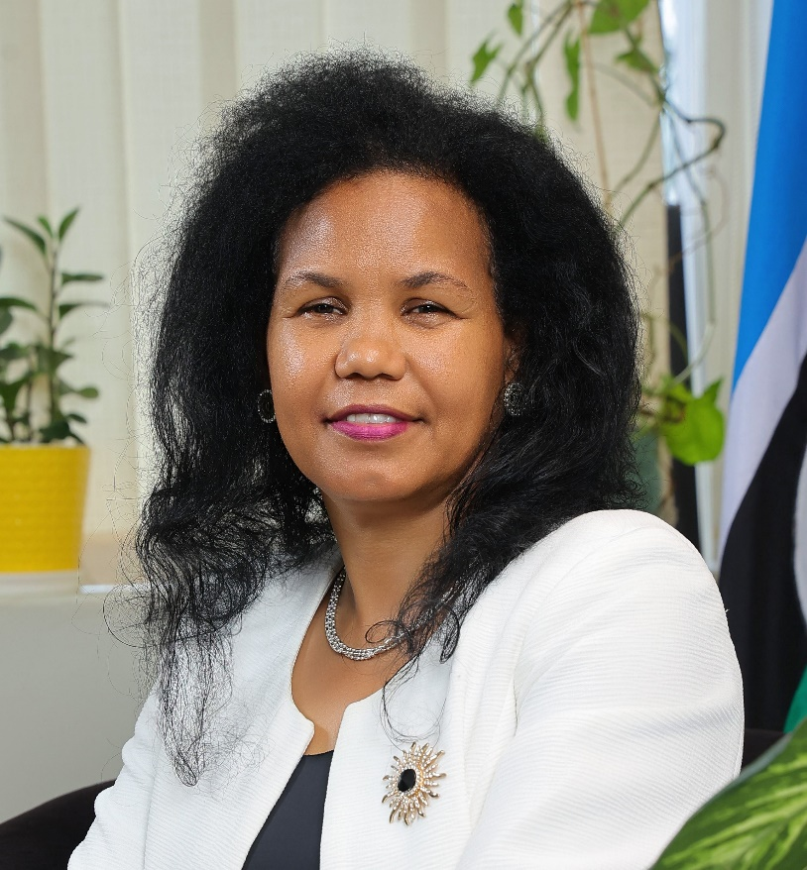
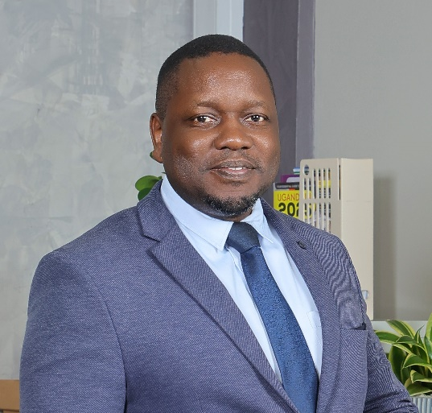
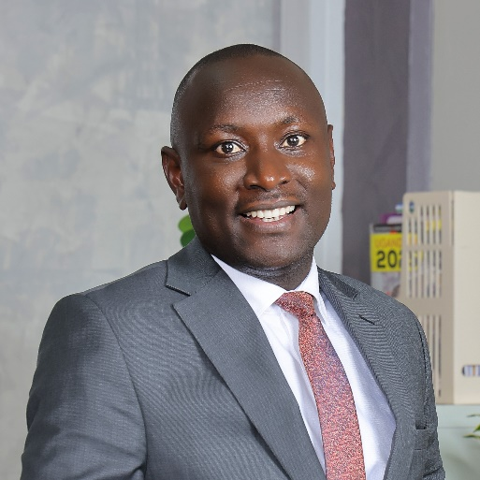
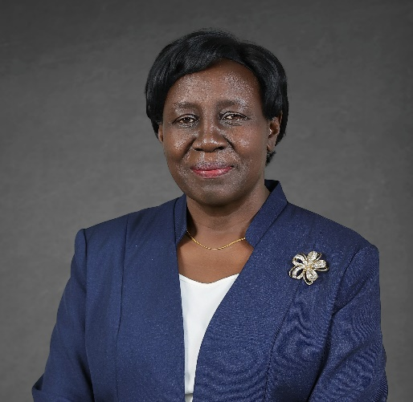
SENIOR MANAGEMENT TEAM
DR. MICHAEL M. LUGEMWA
Director Finance & Operations
MR. ALAN N. LWETABE
Director Investments
MR. PATRICK O. EZAGA
Director Communications
MR. BALAAM SSEMPALA
Director IT
DR. JULIA CLARE OLIMA OYET (MRS.)
Chief Executive Officer
MR. MOSES A. ODONGO
Director Human Capital & Administration
MR. SAMUEL A MANKAATI
Director Internal Audit
MRS. ANGELA K. KANYIMA
Director Legal and Board Secretary
10

Slide 11





MEMBERSHIP AND COVERAGE
Membership
Member Count
Protected Limit
Deposits are
currently
protected up to the limit of UGX 10 Million per depositor per supervised Contributing Institution.
Membership is compulsory for all BOU supervised Deposit-Taking Institutions.
There are 31 members.
21 Commercial Banks, 8 Credit Institutions & 2 MDIs.
Limit Revision
% Coverage
The protection limit was
reviewed from UGX 3 million to UGX 10 million in 2019.
98 % of deposit accounts are fully covered.

Slide 12
FUNDING AND ASSET STRUCTURE
A) Premiums
MAJOR SOURCES OF INCOME:
Annual Premiums – 0.2% of the average deposit liabilities of the previous financial year.
B) Investment Income – from government securities
12

Slide 13

TAKE HOME MESSAGES
Know your bank and
Keep your personal information up to date
1
2
All contributing institutions regulated by BoU are protected.
Depositors don’t pay the premium.
3
4
Avoid rumours.
The current limit is UGX 10m per depositor per bank. Any amount above will be paid by the liquidator depending on recoveries made.
5
6
Foreign currency accounts are protected but first converted to UGX.
DPF does not handle depositor complaints. BoU has a desk to handle them.
7
8
Depositors of EFC and Mercantile who haven’t received their payment are requested to contact DPF.

Slide 14


TAKE HOME MESSAGE – CON’TD
Update your information with your Contributing Institution;
For Individuals: National Identification Number (NIN), an account in an alternative bank or mobile number registered in the account holder’s name.
For Foreigners: Valid passport or refugee card.
For Joint Account Holders: National Identification Numbers of Account holders.
For Company Accounts: Company Registration Number issued by Uganda Registration Services Bureau (URSB).
Accounts for Minors: National Identification Number of any signatory used.
14

Slide 15
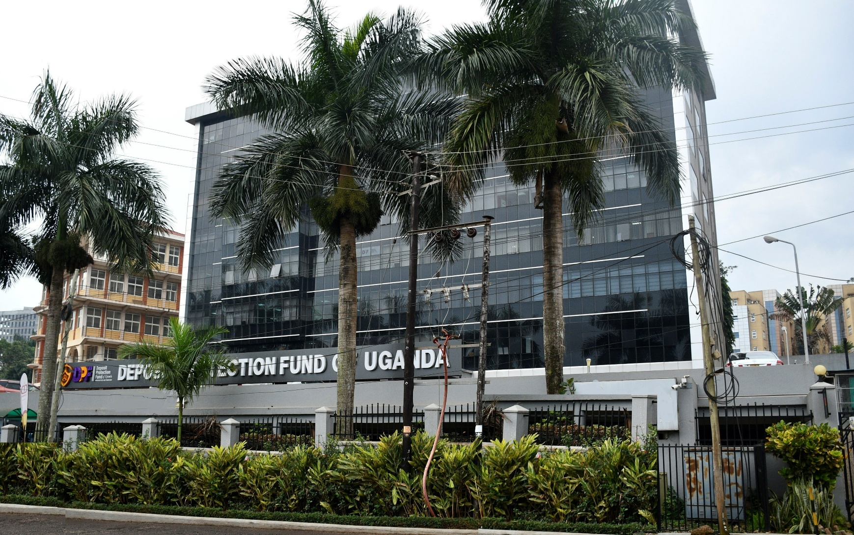





Contact Information
info@dpf.or.ug
www.dpf.or.ug
Director Communications
Patrick Ezaga
Phone no.: +256 709 015 015
Email: patrick.ezaga@dpf.or.ug
Connect with us:
AHA Towers, 3rd Floor,
Plot 7 Lourdel Rd, Nakasero
Deposit Protection Fund of Uganda
15

Slide 16


Kaitaboni
Asante

